Slide 1
Normalization (Bottom up)
STW220CT: Data and Information Retrieval
Prepared By : Kiran Rana

Slide 2
What is Normalization ?
Normalization is a database design technique that organizes tables in a manner that reduces redundancy and dependency of data. Normalization divides larger tables into smaller tables and links them using relationships.
The purpose of Normalization is to eliminate redundant (useless) data and ensure data is stored logically.
Database Normal Forms

Slide 3
Functional Dependency
Student ID | First Name | Surname
9901 | John | Dacus
9902 | Satpal | Singh
9922 | Jagpal | Singh
9911 | John | Smith
Students
For any Student ID, there is one first name and one surname, So, First Name and Surname are functionally dependent on Student ID. We can also say Student ID functionally determines First Name and Surname.
Student ID -> First Name, but not the reverse
Student ID -> Surname

Slide 4
Functional Dependency
A functional dependency is a constraint that describes the relationship between attributes in a relation.
If A and B are attributes of relation R, B is said to be functionally dependent on A (denoted A → B), if each value of A is associated with exactly one value of B.
A → B means B is functionally dependent on A or A functionally determines B.

Slide 5
Partial Dependency
When an non-key attribute is determined by a part, but not the whole, of a composite primary key. This kind of functional dependency is known as partial dependency.
There are two non-key fields : marks and subject_name.
If you know just student_id, can you determine marks?
If you know just subject_id, can you determine marks?
So, marks is partially dependent on student_id and subject_id.
student_id | subject_id | marks | subject_name
1 | 1 | 80 | Database
2 | 1 | 70 | Database
1 | 2 | 90 | Java

Slide 6
Transitive Dependency
Three attributes A, B, and C connected in such a way that A→B and B→C. In other words A→C. If we know the value of A, we can determine B, which we can use in turn to determine C. This kind of functional dependency is known as transitive dependency.
e.g. The functional dependency {Book} → {Author Nationality} applies; that is, if we know the book, we know the author's nationality. Furthermore:
{Book} → {Author} {Author} does not → {Book} {Author} → {Author Nationality}
Therefore {Book} → {Author Nationality} is a transitive dependency.
Notes:
A → B means A functionally determines B.
6

Slide 7
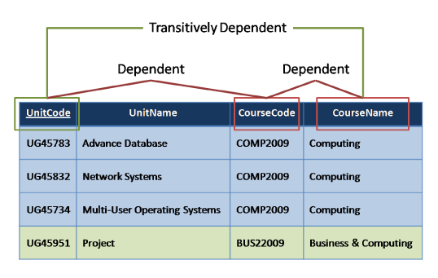
Transitive Dependency
Notes:
A → B means A functionally determines B.
7

Slide 8
Anomalies
Anomalies are inconvenient or error-prone situation arising when we process the tables. There are three types of anomalies:
Insert Anomalies
Update Anomalies
Delete Anomalies
Notes:
Anomalies: Deviation or departure from the normal or common order, form, or rule. One that is peculiar, irregular, abnormal, or difficult to classify.
8

Slide 9
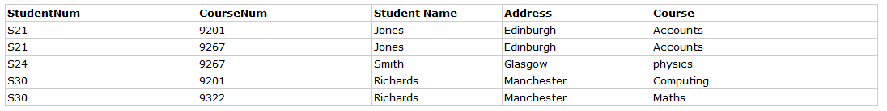
Activity: Insert Anomalies
An Insert Anomaly

Slide 10
Update Anomalies
An Update Anomaly

Slide 11
Repeating groups
Delete Anomaly
Notes:
11

Slide 12
Normal Forms
Un-normalized – There are multivalued attributes or repeating groups
1 NF – No multivalued attributes or repeating groups.
2 NF – 1 NF plus no partial dependencies
3 NF – 2 NF plus remove non-Key dependencies or transitive dependencies

Slide 13
Billing System
Bill No.: 1078
Date: 2013-12-20
Customer Code: C100
Customer Name: Ram Shrestha
ItemCode | ItemName | Rate | Qty
1 | Copy | 20 | 10
2 | Book | 200 | 8
3 | Pen | 10 | 3

Slide 14
UNF (Un-Normalized Form)
The first step is to identify which attributes belong to the repeating group.
Those attributes where there is one occurrence are marked with a ‘1’.
Those attributes where there is a repeating group are marked with a ‘2’.
The tentative primary key is also underlined. In this case it is BillNo.
UNF | UNF Level
BillNo | 1
Date | 1
CustomerCode | 1
CustomerName | 1
ItemCode | 2
ItemName | 2
Rate | 2
Qty | 2

Slide 15
First Normal Form(1NF)
Remove Repeating Group Information
BillNo
Date
CustomerCode
CustomerName
BillNo
ItemCode
ItemName
Rate
Qty
Notes:
15

Slide 16
Second Normal Form (2NF)
Remove Partial Key Dependencies
Identify the attributes that are dependent on only one part of the primary key (composite key) and separate them.
BillNo
Date
CustomerCode
CustomerName
ItemCode
ItemName
Rate
BillNo
ItemCode
Qty
Notes:
16

Slide 17
Third Normal Form (3NF)
Remove Non-Key Dependencies or Transitive Dependencies
Identify the attributes that are functionally dependent on non-key attributes or identify the attributes that are not functionally dependent on primary key.
Here CustomerName is dependent of CustomerCode not BillNo
BillNo
Date
CustomerCode
CustomerCode
CustomerName
BillNo
ItemCode
Qty
ItemCode
ItemName
Rate
Notes:
17

Slide 18
Final ER
BillNo
Date
CustomerCode
BillNo
ItemCode
Qty
ItemCode
ItemName
Rate
CustomerCode
CustomerName

Slide 19
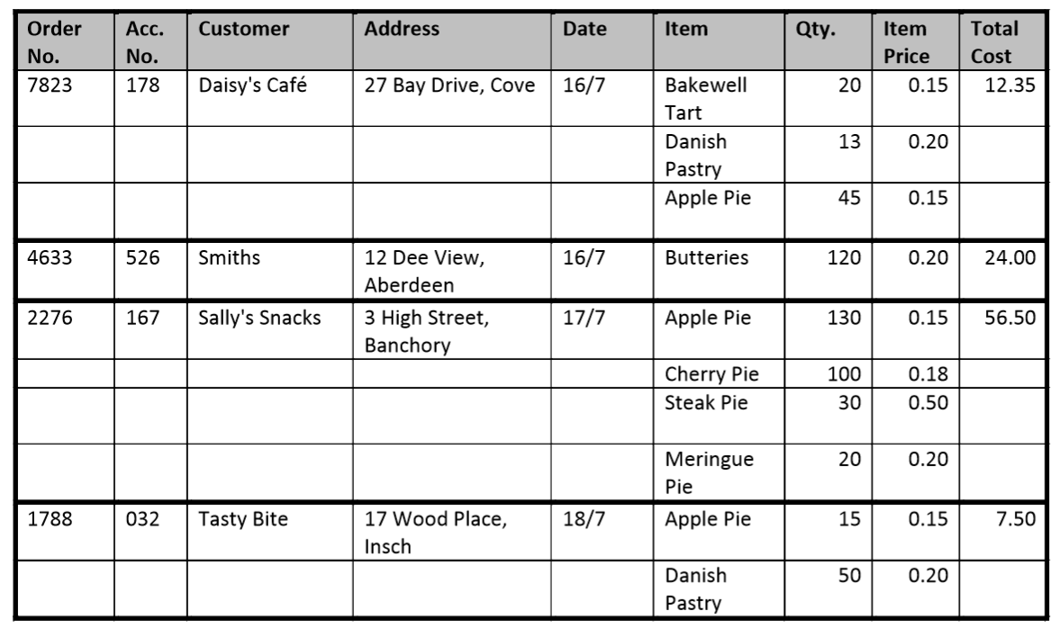
Normalization : Question

Slide 20
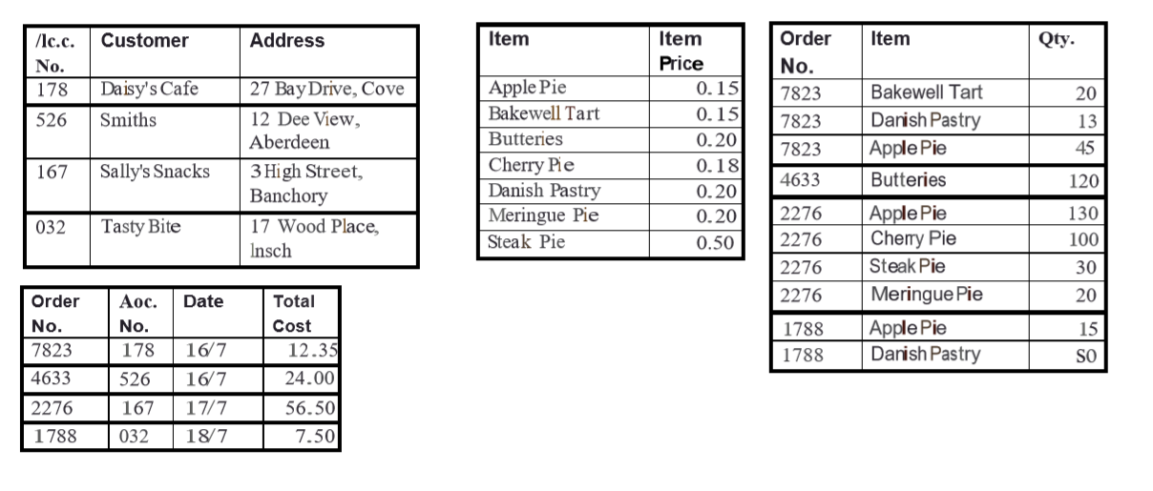
Solution

Slide 21
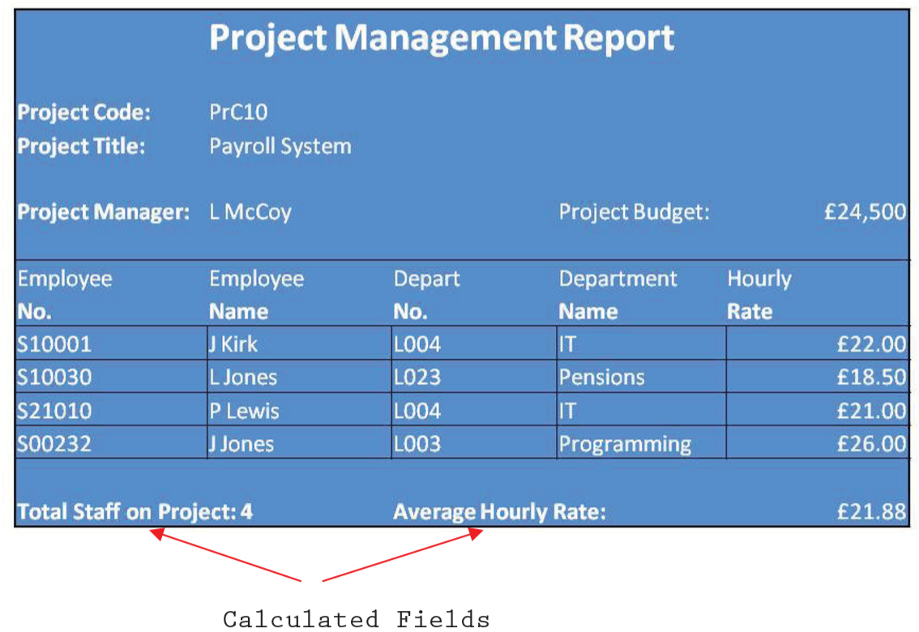
Normalization : Question

